Slide 1


Slide 2
KNOWLEDGE REPERESENTATION
Gidc Degree Engg. College, Abrama
ARTIFICIAL INTELLIGENCE
CODE: 2180703

Slide 3
KNOWLEDGE REPERESENTATION ISSUES
TOPICS
What is KR?
Representation and mapping
Approaches to KR
Issues in KR
The Frame Problem

Slide 4
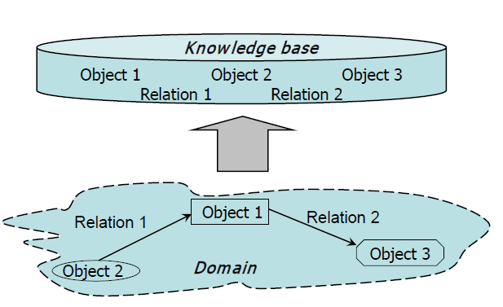
Knowledge base
A knowledge base is an integral part of any knowledge based intelligent system. It maps objects and relationships of the real world to computational objects and relationships.

Slide 5
But What is Knowledge?
Knowledge is an abstract term that attempts to capture an individual’s understanding of a given subject.
In the world of intelligent systems the domain-specific knowledge is captured. Domainis a well-focused subject area.
Cognitive psychologists have formed a number of theories to explain how humans solve problems. This work uncovered the types of knowledgehumans commonly use, how they mentally organizethis knowledge, and how they use it efficiently to solve a problem.

Slide 6
What is KR?
R. Davis, H. Schrobe, P. Szolovits (1993):
A medium for efficient computation
A medium of human expressions
The object of knowledge representation to express knowledge in computer-tractable form, such that it can be used to help intelligent system perform well.

Slide 7
What is KR?
a representation is a set of conventions about how to describe a class of things.
A description makes use of the conventions of a representation to describe some particular thing.
The function of any representation scheme is to capture essential features of a problem domain and make that information available to a problem solving procedure.

Slide 8
What is KR?
A representationconsists of four fundamental parts:
A lexical part that determines which symbols are allowed in the representation’s vocabulary.
A structural part that describes constraints on how the symbols can be arranged.
A procedural part that specifies access procedures that enable to create descriptions, to modify them, and to answer questions using them.
A semantic part that establishes a way of associating meaning with the description.

Slide 9
Kind of Knowledge
Things we need to talk about and reason about; what do we know?
Objects
Descriptions
Classifications
Events
Time sequence
Cause and effect
Relationships
Among objects
Between objects and events
Meta-knowledge

Slide 10
Representation and Mapping
Facts: things we want to represent.
Representations of facts: things we can manipulate.
Structuring these entities as two levels
The Knowledge Level : facts are described
The Symbol Level : represented facts can be manipulated

Slide 11
Representation and Mapping
reasoning programs
Facts
Internal
Representations
English understanding
English generation
English
Representations

Slide 12
Representation and Mapping
Initial
facts
desired real reasoning
Final
facts
forward representation mapping
backward representation mapping
Internal
representations
of initial facts
Internal
representations
of final facts
operation of program

Slide 13
Representation and Mapping
Spot is a dog
dog(Spot)
Every dog has a tail
∀x: dog(x) → hastail(x)
hastail(Spot)
Spot has a tail

Slide 14
Representation and Mapping
Fact-representation mapping is not one-to-one.
Good representation can make a reasoning program trivial.

Slide 15
Representation and Mapping
No. black squares = 30
No. white square = 32

Slide 16
Approaches to KR
Good representation has following properties:
Representational adequacy
Inferential adequacy
Inferential efficiency
Acquisitional efficiency

Slide 17
Approaches to KR
Simple relational knowledge:
Provides very weak inferential capabilities.
May serve as the input to powerful inference engines.

Slide 18
Approaches to KR
Inheritable knowledge:
Objects are organized into classes and classes are organized in a generalization hierarchy.
Inheritance is a powerful form of inference, but not adequate.
Slot and Filler structure / Semantic Network / Collection of Frames

Slide 19
Approaches to KR
Inferential knowledge:
Facts represented in a logical form, which facilitates reasoning.
An inference engine is required.

Slide 20
Approaches to KR
Procedural knowledge:
Representation of “how to make it” rather than “what it is”.
Operational
May have inferential efficiency, but no inferential adequacy and acquisitional efficiency.

Slide 21
Issues in KR
Are any attributes of objects so basic that they occur in almost every problem domain?
Are there any important relationships that exits among object attributes?
At what level of detail should knowledge be represented?
How should sets of objects be represented?
Given a large amount of knowledge stored, how can relevant parts be accessed?

Slide 22
Issues in KR
Important attributes:
Instance
Isa

Slide 23
Issues in KR
Relationships among attributes:
Inverses
Isa hierarchy

Slide 24
Issues in KR
Choosing the Granularity:
High-level facts may not be adequate for inference.
Low-level primitives may require a lot of storage.

Slide 25
Issues in KR
Representation of sets of objects:
By names.
By extensional definition.
By intensional definition.

Slide 26
Issues in KR
Finding the right structures:
Selecting an initial structure.
Revising the choice.

